Slide 1
Client & server

Slide 2
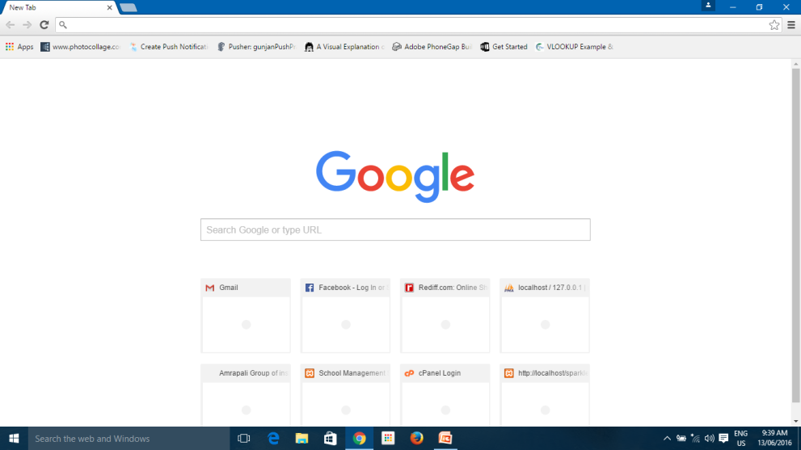
PHP
ASP
ASP.Net
JSP etc…
HTML
CSS
JS
JQ
Bootstrap etc..
Database

